Slide 1
DIAS: Decentralized Internet Applications and Services
Final Project Presentation
4/22/14
Adriana Flores
Clayton Shepard
Ellis Giles
Yanda Lu
Haiuhua Shen

Slide 2
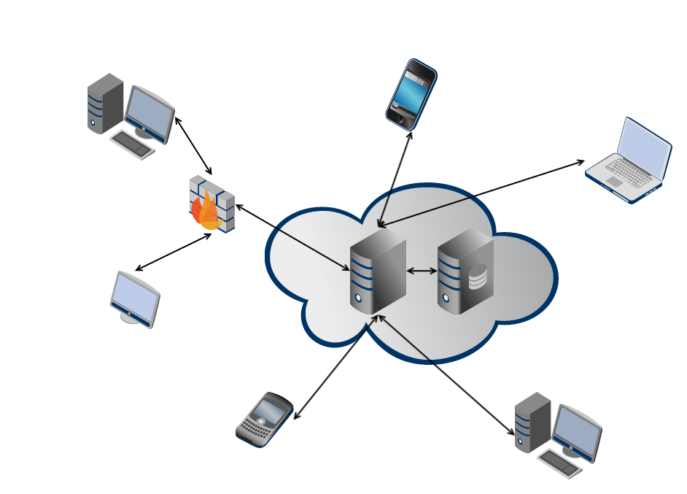
Problem: Centralized Architecture
Single point of failure
Privacy
Security
Control over data
Energy efficiency
Power hungry data centers
Google: 260 million watts [1]
[1] Glanz, James . “Google Details, and Defends, Its Use of Electricity.” The New York Times 8 Sep. 2011
Notes:
. Use 2 minutes to remind audience the problem/question that you want to address
====
centralized servers have many drawbacks, ranging from
privacy, security, and fault-tolerance, to even energy-efficiency and control over data
Power-hungry data centers
According to Google their global data center operation electrical power ranges between 500 and 681 megawatts.
quarter of the output of a nuclear power plant
Decentralize the current server-client mode paradigm in the current Internet

Slide 3
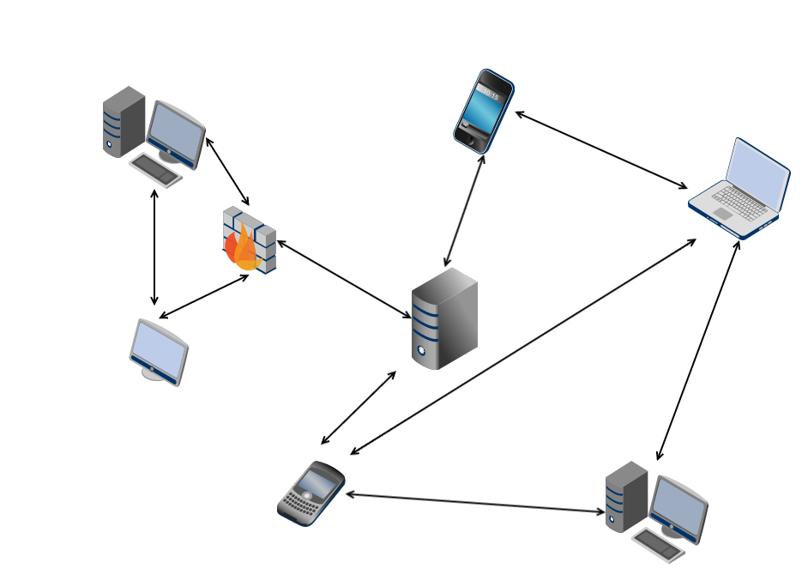
Decentralized Architecture
Robust to failure
Single point of failure
Full ownership and storage of your data
Privacy
Security
Control over data
Self-devices energy consumption
Energy efficiency
Power hungry data centers
Google: 260 million watts [1]
Notes:
. Use 2 minutes to remind audience the problem/question that you want to address
====
centralized servers have many drawbacks, ranging from
privacy, security, and fault-tolerance, to even energy-efficiency and control over data
Power-hungry data centers
According to Google their global data center operation electrical power ranges between 500 and 681 megawatts.
quarter of the output of a nuclear power plant
Decentralize the current server-client mode paradigm in the current Internet

Slide 4
DIAS: Decentralized Internet Applications and Services
Goal:
Decentralize the current server-client model
Replace servers with point to point communication for personal communication and services
Benefits:
Challenges:
Security
Privacy
Resilience
Cost
Power
Redundancy
Uptime
Failover
Battery Management
Notes:
. Use 2 minutes to remind audience the problem/question that you want to address
=========
How do we ensure reachability?
What happens if the cellphone loses connectivity?
What if it is lost/broken/stolen?
We need to find novel methods to ensure redundancy for both uptime and data.
Redundancy
Uptime
Data

Slide 5
DIAS Architecture
DIAS Core
Different Services
Problem:
Roll their own logging
Name resolution
Configuration Files
Saving / Reading Data Files
Different User Interfaces
Solution:
Common Service Interface for Utilization!
Services
Web
App
Email
SSH
Rsync
…
Proxy (SOCKS5)
Command Line Interface
Runs on any Java Enabled Computer
Logging System
DIAS Android
Name Resolver
Runtime Configuration
Tabbed GUI
Start/Stop Services
Logging
Peer-To-Peer
Rice Pastry Network
Battery
Power Analysis
Notes:
. Use 10 minutes to explain in detail your solution or approach to address the problem/question

Slide 6

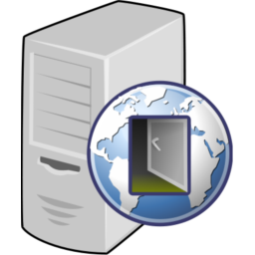
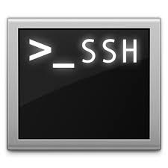
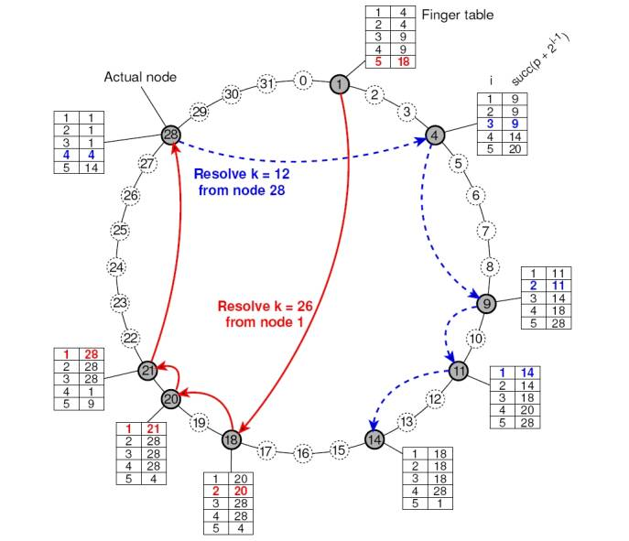

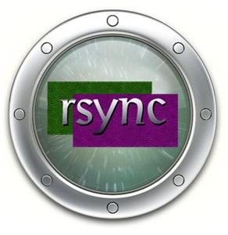
DIAS Implemented Services
Web
SSH
Proxy
Peer to Peer
Email
Replication

Slide 7
DIAS Architecture: Threads
DIAS Core
Function | Threads
Web Server | 5 Threads
Application Server | 5 Threads
Email Server | 2 Threads
SSH Server | 2 Threads
Rsync | 1 Thread
Proxy Server | 5 Threads
Name Resolver | 1 Thread
Rice Pastry | 2 Threads
Monitoring | 1 Thread
Control Threads + Async. User & System Events
Services
Web
App
Email
SSH
Rsync
…
Proxy (SOCKS5)
Command Line Interface
Runs on any Java Enabled Computer
Logging System
Name Resolver
Runtime Configuration
Tabbed GUI
Start/Stop Services
Logging
Peer-To-Peer
Rice Pastry Network
Battery Power & Net Monitori
Notes:
. Use 10 minutes to explain in detail your solution or approach to address the problem/question

Slide 8
DIAS Architecture: Node Naming
Suppose I want to run DIAS on my machine
How can others find my node if I need a fully qualified domain name?
Virtual Private Network can provide a central naming authority but becomes a central point of failure – against a decentralized Internet
Dynamic DNS solves some issues such as host IP changing, but hosts can be NAT’d behind firewalls or not available with stale entries.
One solution is provide naming resolution through an overlay network.
Browsers and Applications will cache my node name too, so what happens if I change IP or failover?
DIAS users (or others) can use a service that will lookup names through the overlay network or DNS and not cache names.

Slide 9
DIAS Architecture: Node Naming
Domain Name System – DNS Entry Time-To-Live
Host Caching of Domain Names
OS (Linux, Android, etc.)
Host Machine
Host and Application Level Solutions:
Host Networking Libraries
(usually respect TTL values and cache the DNS entry)
Set a low Time-To-Live (TTL)
Entry in Domain Name System - DNS Records
Java InetAddress Library
(Caches Entry Internally To the Class – Sometimes Indefinitely)
Implement a Java Security Manager
Policy to set to zero the network. address.cache.ttl and .negative.ttl
JVM
Variant
User Application Level Caching
DNS Entries
Set / Configure / Modify Applications to use a Proxy Server

Slide 10
DIAS: Proxy

Slide 11
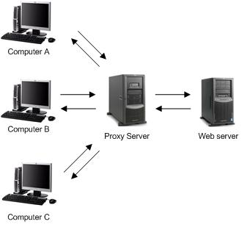
DIAS Architecture: Proxy
Now Embed the Proxy Server as software with DIAS…
Proxy Server
DIAS Android
Runtime Configuration
Tabbed GUI
Start/Stop Services
Logging
Battery
Power Analysis
Utilization of the proxy on localhost server can be problematic.
DIAS Core
Services
Proxy (SOCKS5)

Slide 12
DIAS Architecture: Proxy
Specifying the Proxy Server to localhost on a Wi-Fi Connection on Android doesn’t work.
There’s no bypass rules, so all traffic goes through the localhost proxy.
Thus, when the localhost proxy tries to reach the network, it is proxied itself and eventually crashes.
Specifying a Proxy Server on a cellular connection isn’t recognized.
Google Chrome and Android’s built in Internet browser don’t support user proxy server.
Use Mozilla Firefox or embed a Web browser (Web View and set proxy by Java Reflection into core class provided by Android).

Slide 13

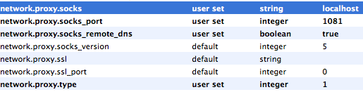
DIAS Architecture: Proxy
Mozilla Firefox has Socks Proxy support built in for both desktops and Android.
Set parameters to use Socks 5.
about:config
Search for proxy:

Slide 14
Domain/Node Name Resolution
Now we have a proxy, so what?
User Application
Configured for DIAS localhost 1081 SOCKS
Connects lh:1081 & Sends
SOCKS: 5
Connect: facebook.com
Name Resolver
Checks Name Cache
If Valid and not expired can return value, else lookup.
Name / IP / Time
Cache (Short TTL)
In Parallel check both DNS and the DIAS overlay, e.g. query node Name & check for return value after timeout.
Regular DNS Query
Query the DIAS Pastry Overlay

Slide 15
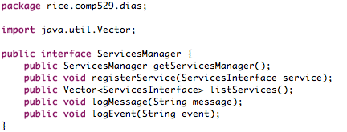
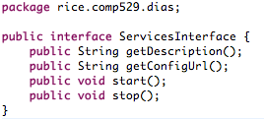


Proxy Jsocks
1081
Other Services
Nano HTTPD
Web
8085
RSync
App
8080
Email
2525
SSH
22

Slide 16
DNS Server
Fairly Standard BIND9 server
Lots of scripting to setup naming architecture
Name | Type | Value | Description
clay.elec529 | A | 168.7.138.104 | Main host record
m.clay.elec529 | A | 168.7.138.104 | Permanent master record
1.clay.elec529 | CNAME | adriana.elec529 | First failover
n.clay.elec529 | CNAME | node.elec529 | Nth failover
clay.elec529 | MX | clay.elec529 | Mail, priority, 1
clay.elec529 | MX | 1.clay.elec529 | Mail failover, priority 10

Slide 17
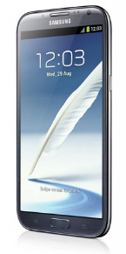

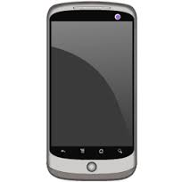
Dynamic DNS Failover
nsupdate to make changes without reloading server
/etc/ppp/ip-up runs nsupdate to change ips
API provided to Android for other changes
E.g. battery based failover
Intended node down!
Failover node to the rescue!
User

Slide 18
VPN Server
PPP, xl2tpd, and openswan (ipsec)
Fairly Standard
Small caveats
VPN end point on network (routing loop)
1 to 1 NAT

Slide 19
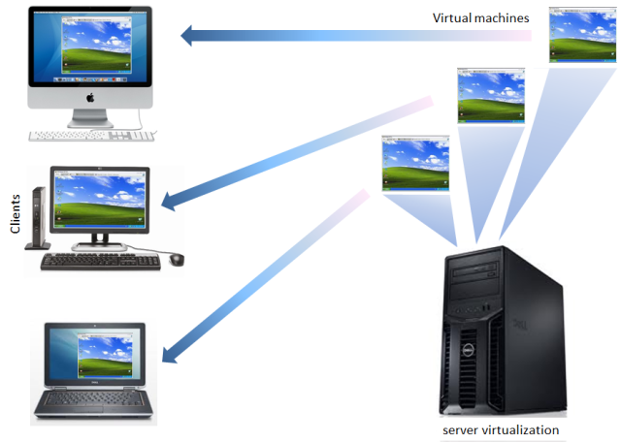
VM Test Environment
Not enough phones
Spin up VMs on same IPs
Test JES, ssh, etc.
adriana.elec529.recg.rice.edu
ellis.elec529.recg.rice.edu
clay.elec529.recg.rice.edu

Slide 20
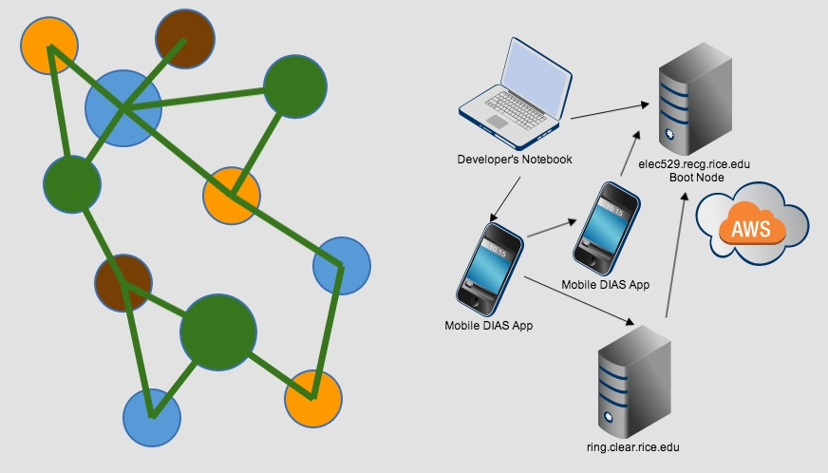
DIAS Overview

Slide 21
DIAS: Web Server

Slide 22

DIAS: Web Server
Nano HTTPD
Small
Single Java File
Embedded Systems
Multi-Threaded – 5 Threads
Port 8085
Modified to conform to Dias Service Interface
Modified to implement Dias Logging Service

Slide 23

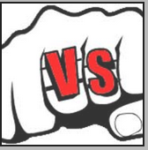
DIAS: Web Server
Serverlet Engine
Support Java EE
Used NIO for I/O
For Large Number but Not Busy Connection
Small Memory Occupation
Flexible
Serverlet Engine
Support Java EE
Used BIO for I/O
For Small Number but Very Busy Connection
Large Memory Occupation
Integration

Slide 24
DIAS: Web Server
Jetty Introduction
A Web server and javax.servlet container, plus support for SPDY, WebSocket, OSGi, JMX, JNDI, JAAS and many other integrations.
These components are open source and available for commercial use and distribution
http://www.eclipse.org/jetty/
Powered
Large clusters
- Yahoo! Hadoop Cluster
Cloud computing
- Google App Engine
SaaS
- Yahoo! Zimbra
Application Servers
- Apache Geronimo
Frameworks
- Google Web Toolkit
Devices
- Android Mobile OS
Eclipse Foundation
A not-for-profit, member supported corporation that hosts the Eclipse projects and helps cultivate both an open source community and an ecosystem of products and services.

Slide 25
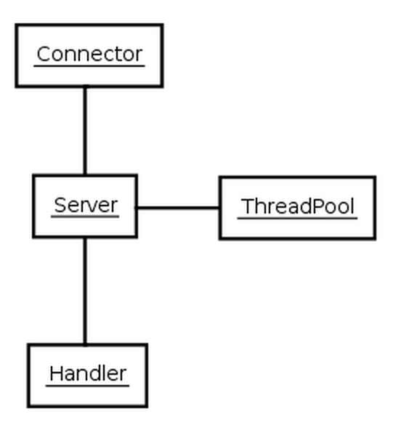
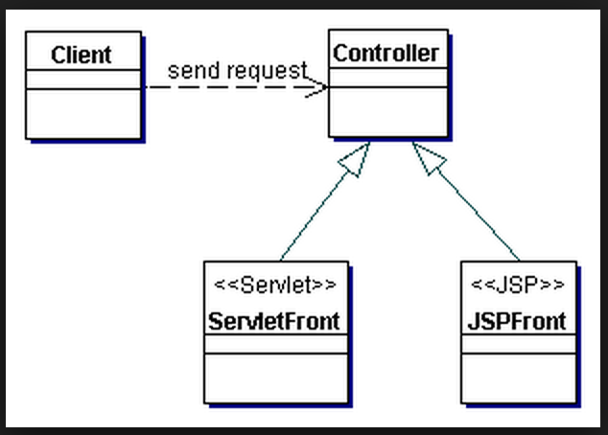
DIAS: Web Server
The Structure of Jetty – View From 20000 Feet
Controller
- Connector
- Client
- Queue
- Thread
View
- JSP Front
- Mobile Phone

Slide 26
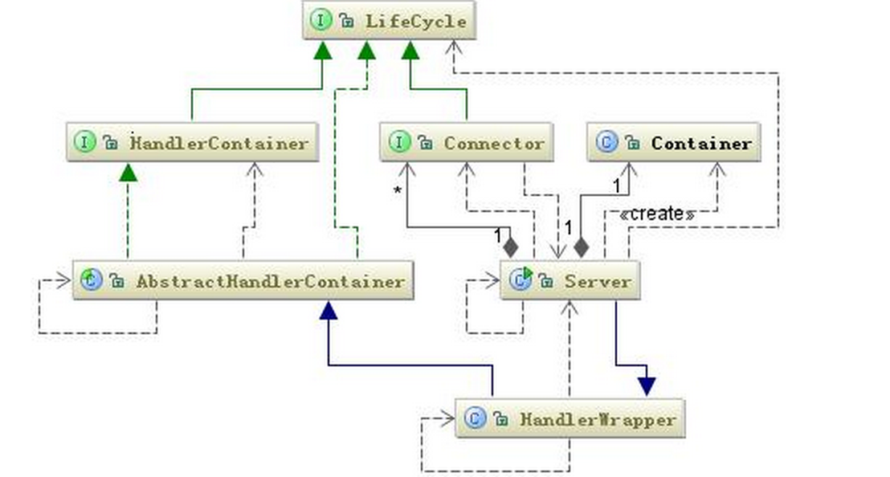
DIAS: Web Server
Model – Handler – Observable Design Patter
Implement Handler
Add Handler
Start Handler

Slide 27
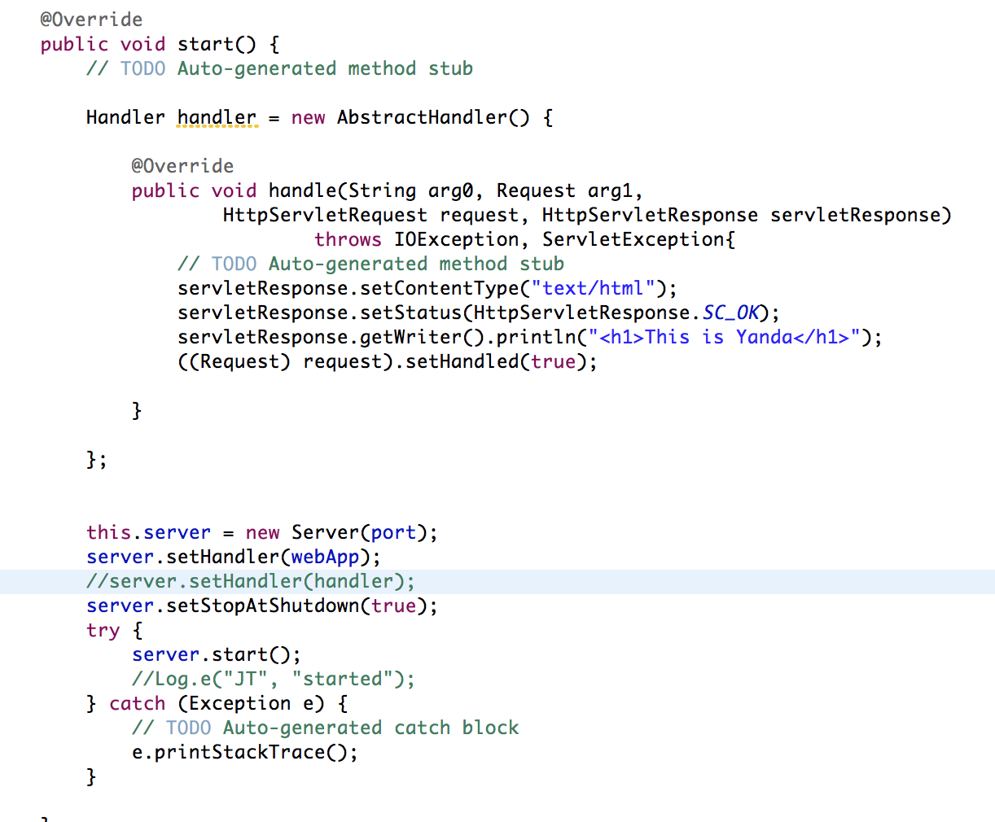
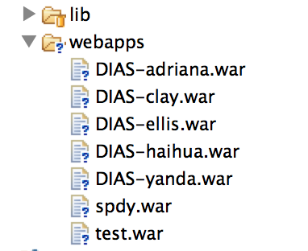
DIAS: Web Server
Embed Start

Slide 28
DIAS: Email Server

Slide 29
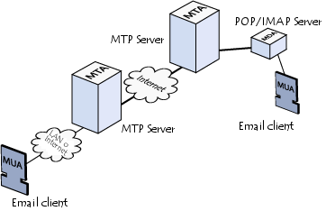
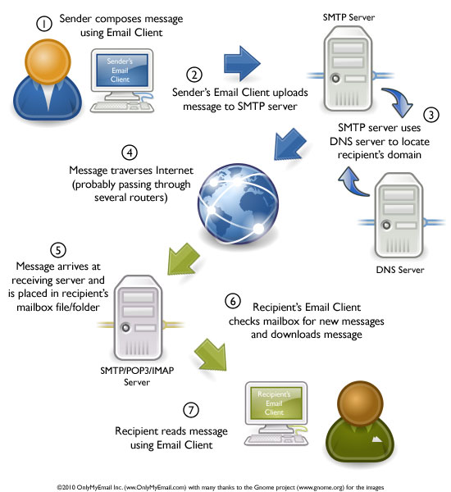
DIAS: Email Server
MTA: Mail Transport Agent
MTAs communicate with one another using the protocol SMTP
MDA: Mail Delivery Agent
POP3 (Post Office Protocol)
IMAP (Internet Message Access Protocol)
MUA: Mail User Agent
Notes:
MTAs tasked with transporting emails
The recipient's MTA then delivers the email to the incoming mail server (called the MDA)
MDA is protected by a user name called a login and by a password.
MTAs act as the post office
the sorting area and mail carrier, which handle message transportation
MDAs act as mailboxes, which store messages (as much as their volume will allow) until the recipients check the box.

Slide 30
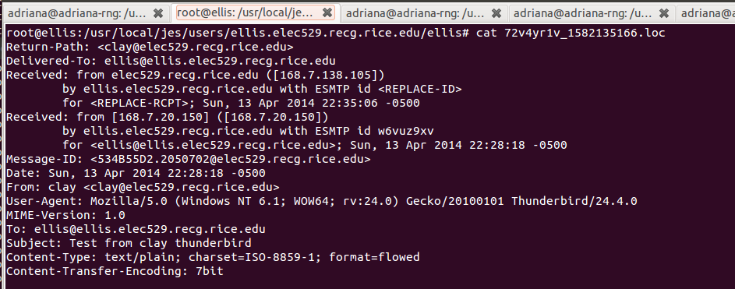
JES – Java Email Server
JES is a multi-featured hybrid MTA/MDA server written in the java programming language
Secure socket connections:
TLSv1, SSLv3
Authentication mechanisms:
SASL PLAIN, LOGIN, CRAM-MD5, DIGEST-MD5, SCRAM-SHA1, GSSAPI
Use filesystem to store emails

Slide 31
JES – Java Email Server
Mail.xml
Domains
Users
Passwords
JES-DNS
In-house software library to resolve IP and dns names
Logger
JES allows commons-logging
log4j
Configuration
Mail.conf : Ports, # Threads, global security
User.conf: local users and their pswd
Log.conf – loads logj4 properties files
Service Wrapper
Wrapper.conf
Starting JES
Mail.sh
Execute JES from command line
JAVA_EXEC, JES_HOME
Security
Java Cryptography Extension (JCE)
JES Vault & Master Password
JSSE keystore password
STARTTLS SMTP/POP3 extension
Configuration Manager BackEnd
Domains, users and digest-MD5 realms
File system or Database
Notes:
Port 25
JES complex software has multiple components

Slide 32
DIAS: SSH & Replication

Slide 33
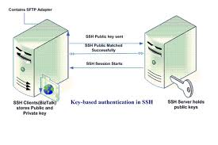
DIAS: SSH Server
Keys, paths, permissions, and env!
Very hard to get right.
Provides authentication for everything
Based on OpenSSH
Thread sets config, then monitors it.

Slide 34
DIAS: Data Replication (rsync)
Keys, paths, permissions, and env!
Yes, again. This was hard. And ridiculous.
Runs over SSH
Public Key Authentication
Very efficient
Diffs files, and only sends modified blocks
Two Modes: full and sparse replication
Notes:
To get rsync to work:
Had to use dropbear client
Had to run from shell. (and had to call from shell)
Tons of weird errors (for example dos format).

Slide 35
Peer to Peer

Slide 36
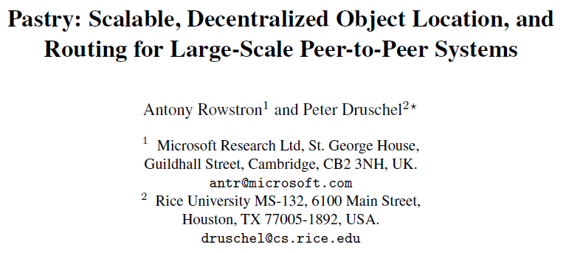
Notes:
2001

Slide 37
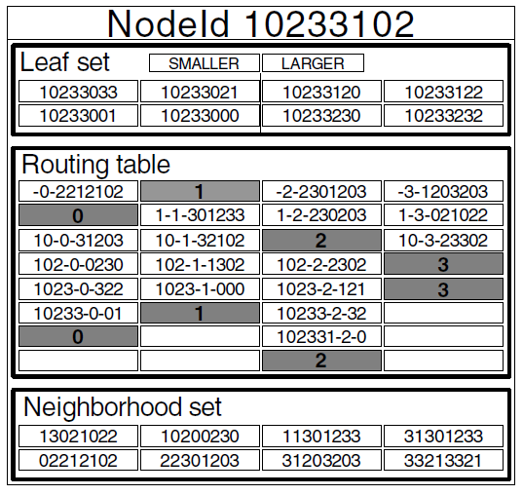
Pastry is a generic p2p content location and routing system based on a self-organizing overlay network of nodes connected via the Internet.

Slide 38
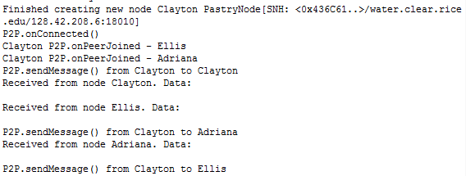
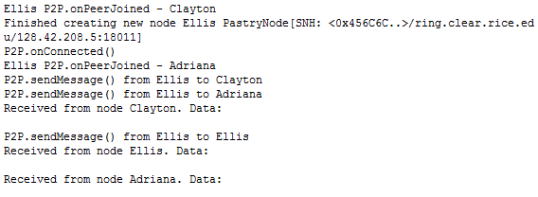
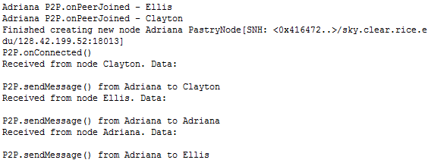
Pastry is completely decentralized, fault-resilient, scalable, and reliably routes a message to the live node with a nodeId numerically closest to a key.

Slide 39

Pastry can be used for applications like file sharing, file storage, group communication, and naming systems.

Slide 40
Android APP & Demo

Slide 41
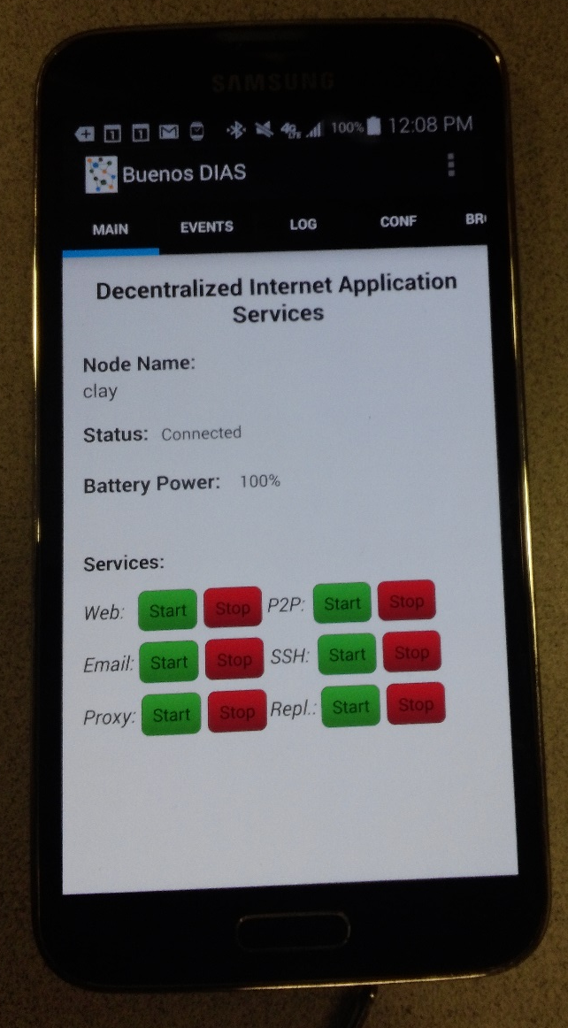
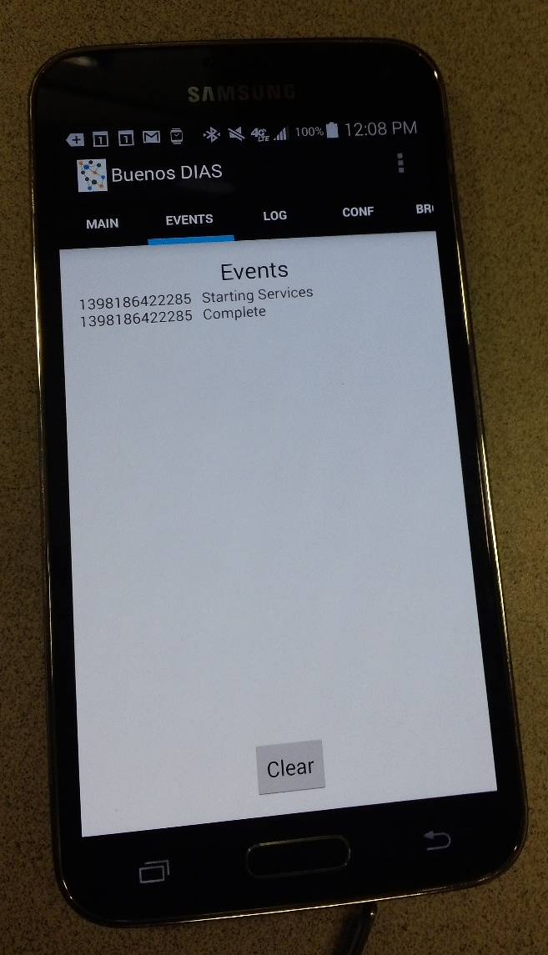
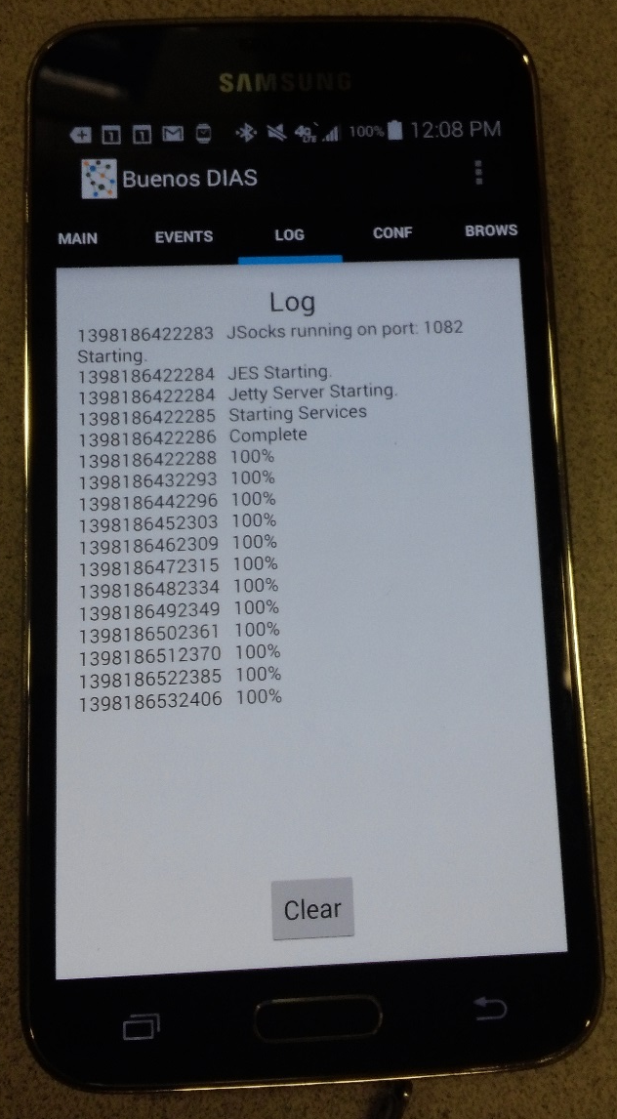
DIAS Android Application

Slide 42
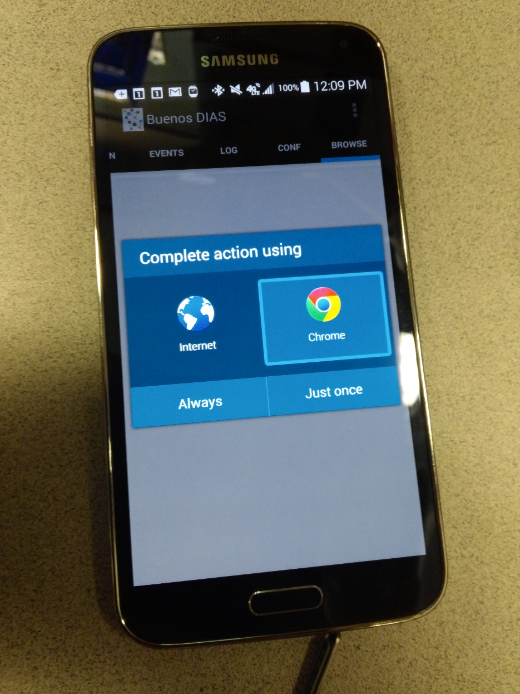
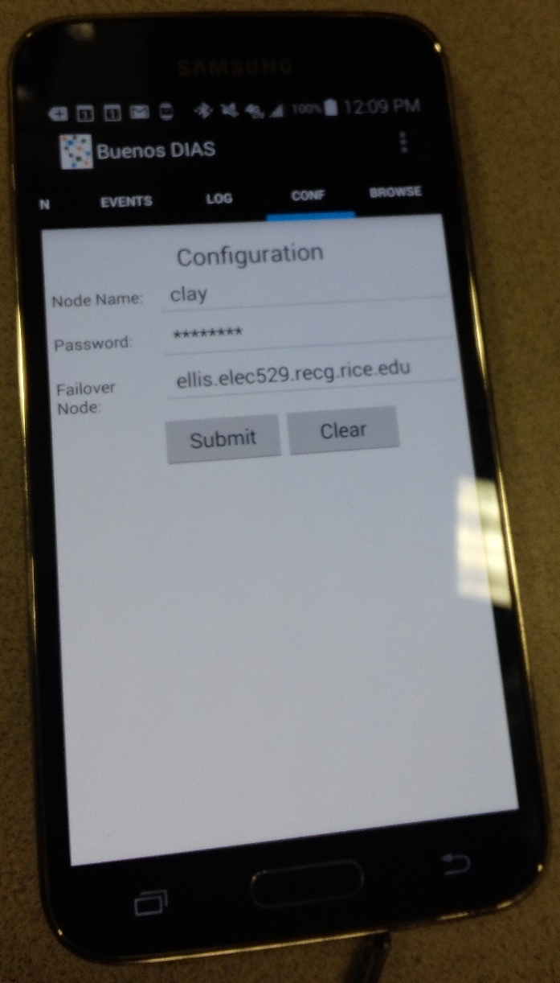
DIAS Android Application

Slide 43
DEMO

Slide 44
Experiments
Testing of individual services
Jetty, Kirium, etc.
DNS and Proxy Testing
Nano HTTPD Testing
Email Testing
Battery Tests
Galaxy S4 Running DIAS
Two Hour Tests:
Regular Usage 5%
Streaming 2.35 GB Data 28%
DIAS Regular Usage with proxy 10%
Replication: Rsync and SSH Testing

Slide 45



Demo Network Architecture
ellis.elec529.recg.rice.edu
VPN
Rice Owls
Internet
Client
clay.elec529.recg.rice.edu
adriana.elec529.recg.rice.edu

Slide 46
conclusions

Slide 47
Summary
Build a first generation decentralized architecture which supports typical personal communication and applications including:
Email
Web Pages
Benefits:
Security, Privacy, Resilience, Cost, and Power
Challenges:
Redundancy, Uptime, Failover, Battery Management
Development and Integration with Android Application

Slide 48
Forward Work
P2P for transport
Could eliminate VPN
Could use peer for browsing service
P2P for replication
Push files to peers not running rsync
Email server running on a different port
Users don't have to have root, but email may be routed through DIAS servers that have 25 open.
DIAS as a Platform-As-A-Service Model.
Security

